Slide 1
3D Models

Slide 2
Two Different Popular Tools
Maya or Blender
Blender is free, Maya has a free 30 day trial and student license
Either way pick something and roll with it

Slide 3
Maya Tutorials
Maya
https://www.youtube.com/watch?v=tElsku3aKQI

Slide 4
Complexity
We neither need nor want a whole lot of complexity, so don’t stress too much over making something interesting

Slide 5
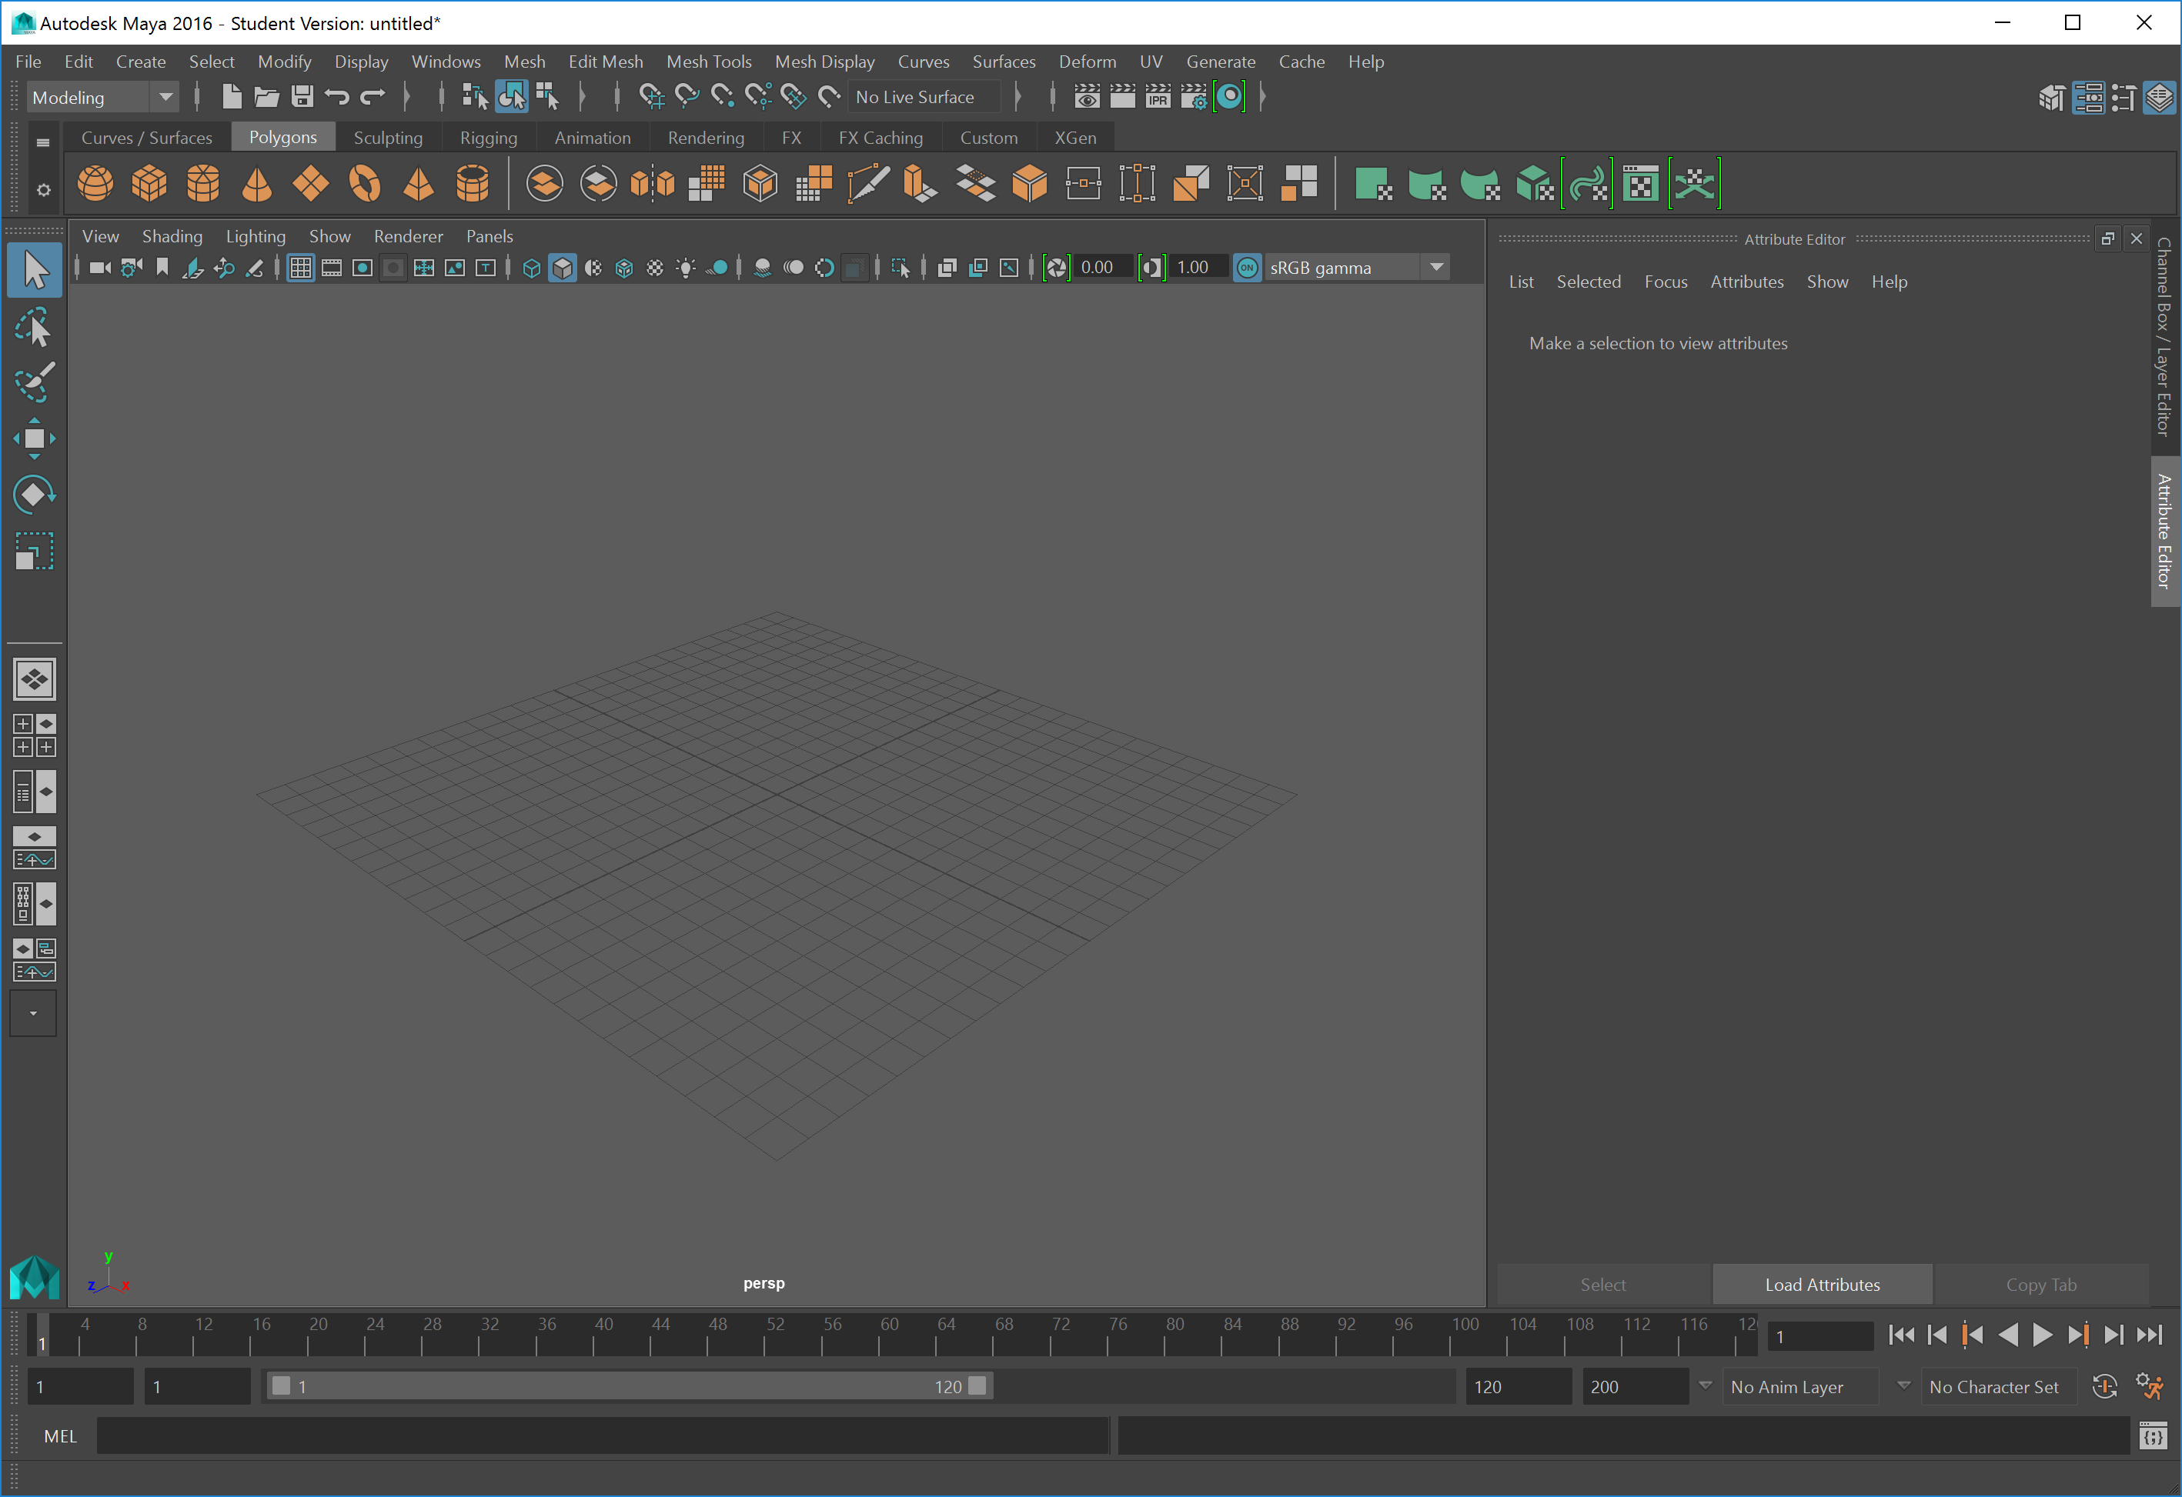

Slide 6
Important Tools
Camera controls – Hold alt + other mouse button
You probably need a 3 button mouse for this, but it’s possible there are other shortcuts for mac

Slide 7
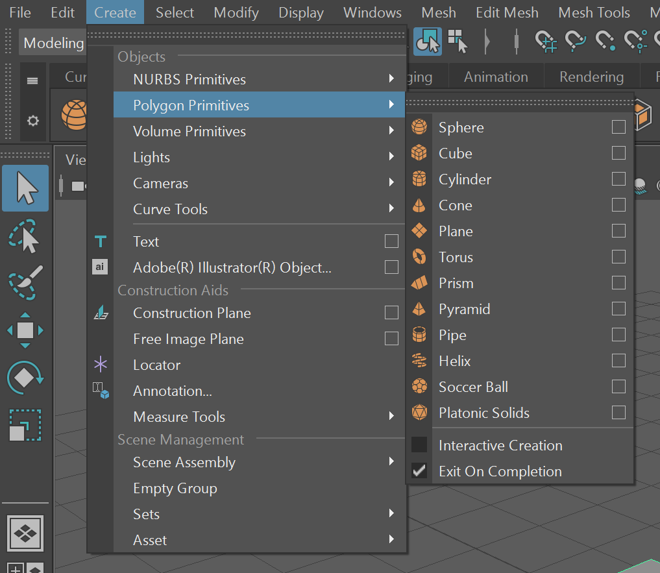

Slide 8
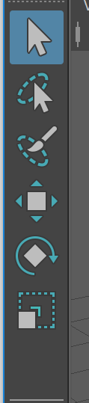
That bar on the left
Menu of tools

Slide 9
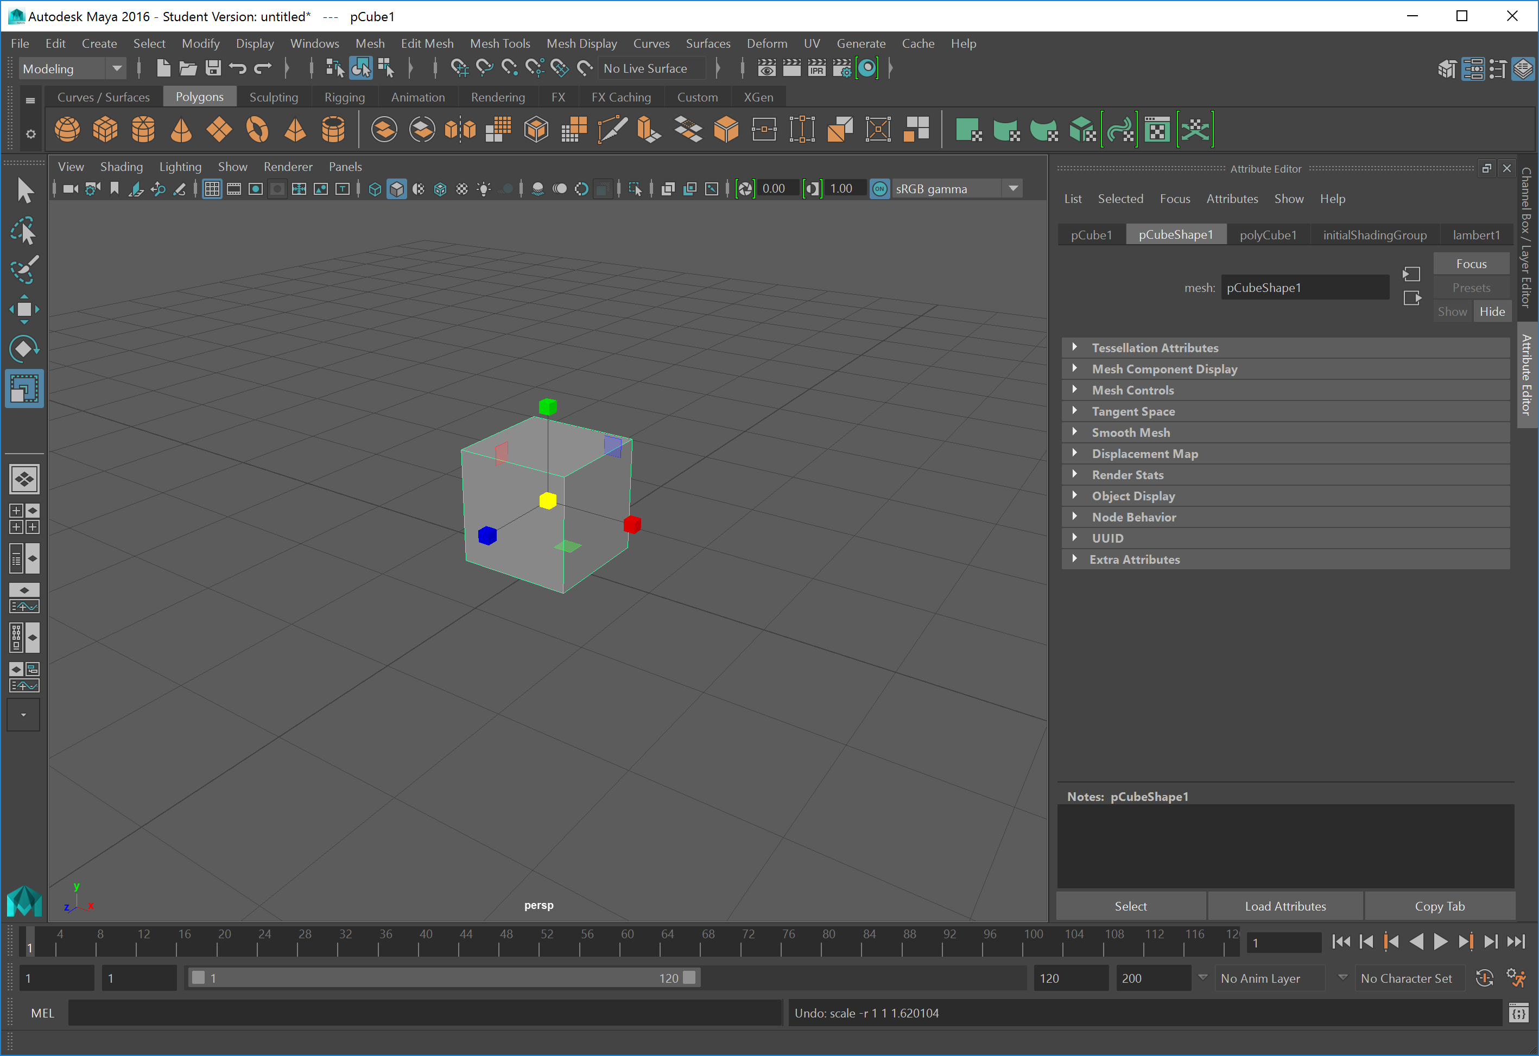
Notes:
Scale tool – yellow box scales the whole thing, the other ones scale/extrude just one part of the surface

Slide 10
Model Operations
You can manipulate edges and vertices one at a time
But this isn’t a course in how to be a 3D artist nor do we have time to dwell on it
Feel free to put as much work into the models as you want

Slide 11
Orthographic Projection
You may find it easier to work in orthographic projection mode
It’s easy to lose things and have them off in space in perspective mode

Slide 12
Rigging (Basic’s of Animation)
https://www.youtube.com/watch?v=CF3rupjYWa4
(10 minute video not 2 hours at least)

Slide 13
Steps
Create the parts you want
Combine their meshes

Slide 14
Rigging - Joint
Joints need to get bound to objects
(Shift select with the joint, press P)
You need to link all of the components together

Slide 15
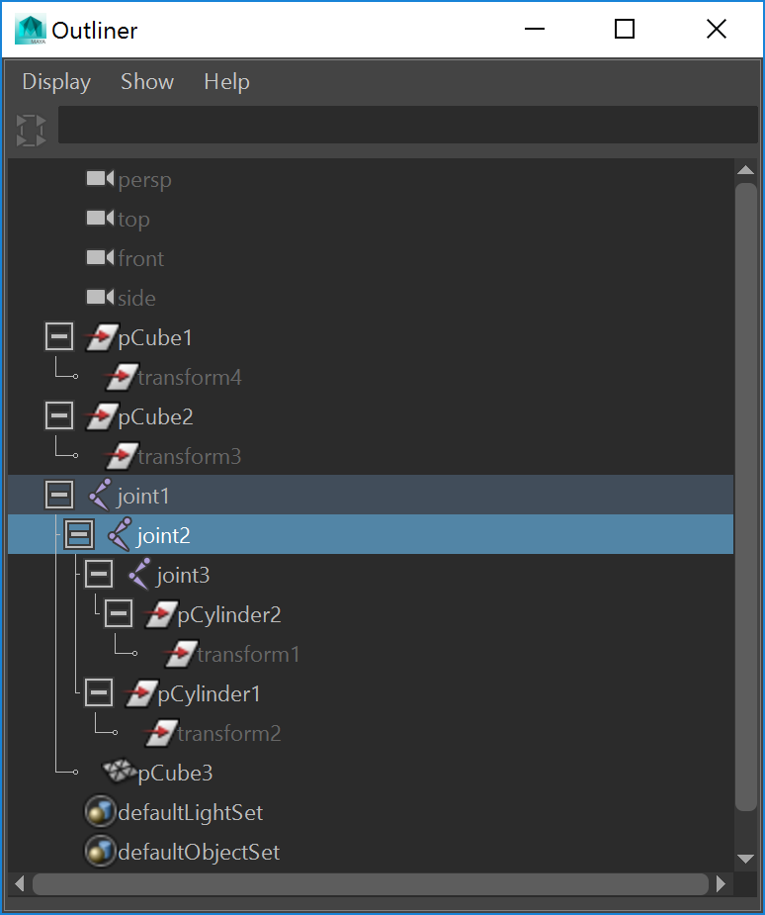

Slide 16
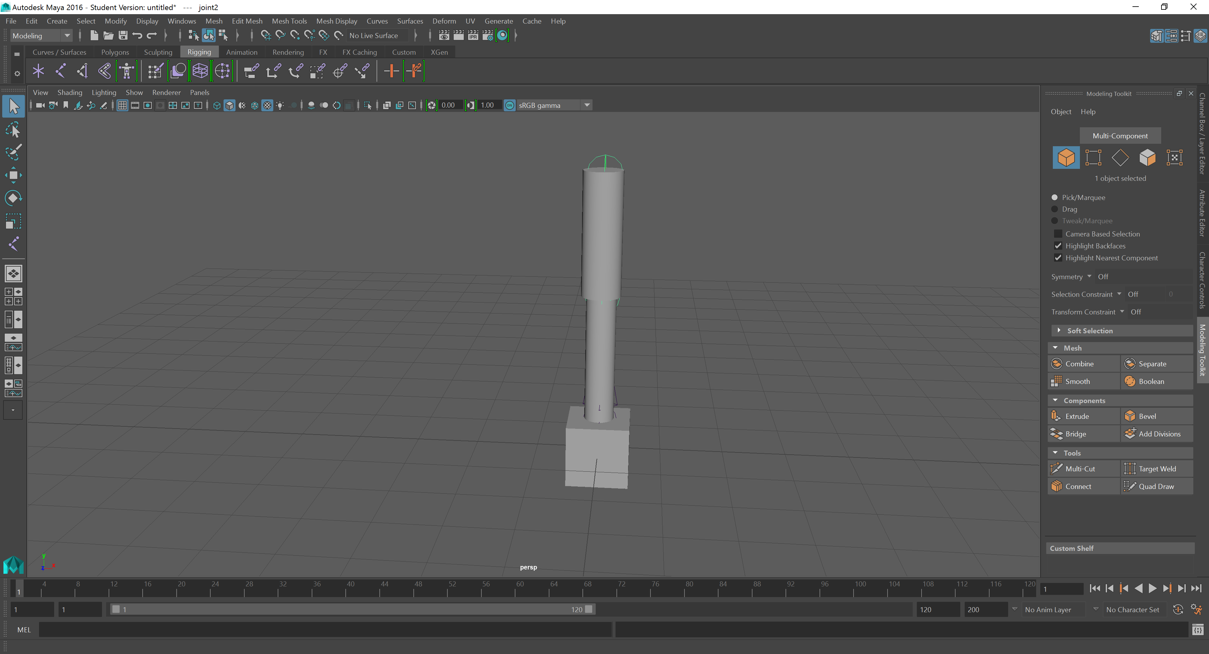

Slide 17
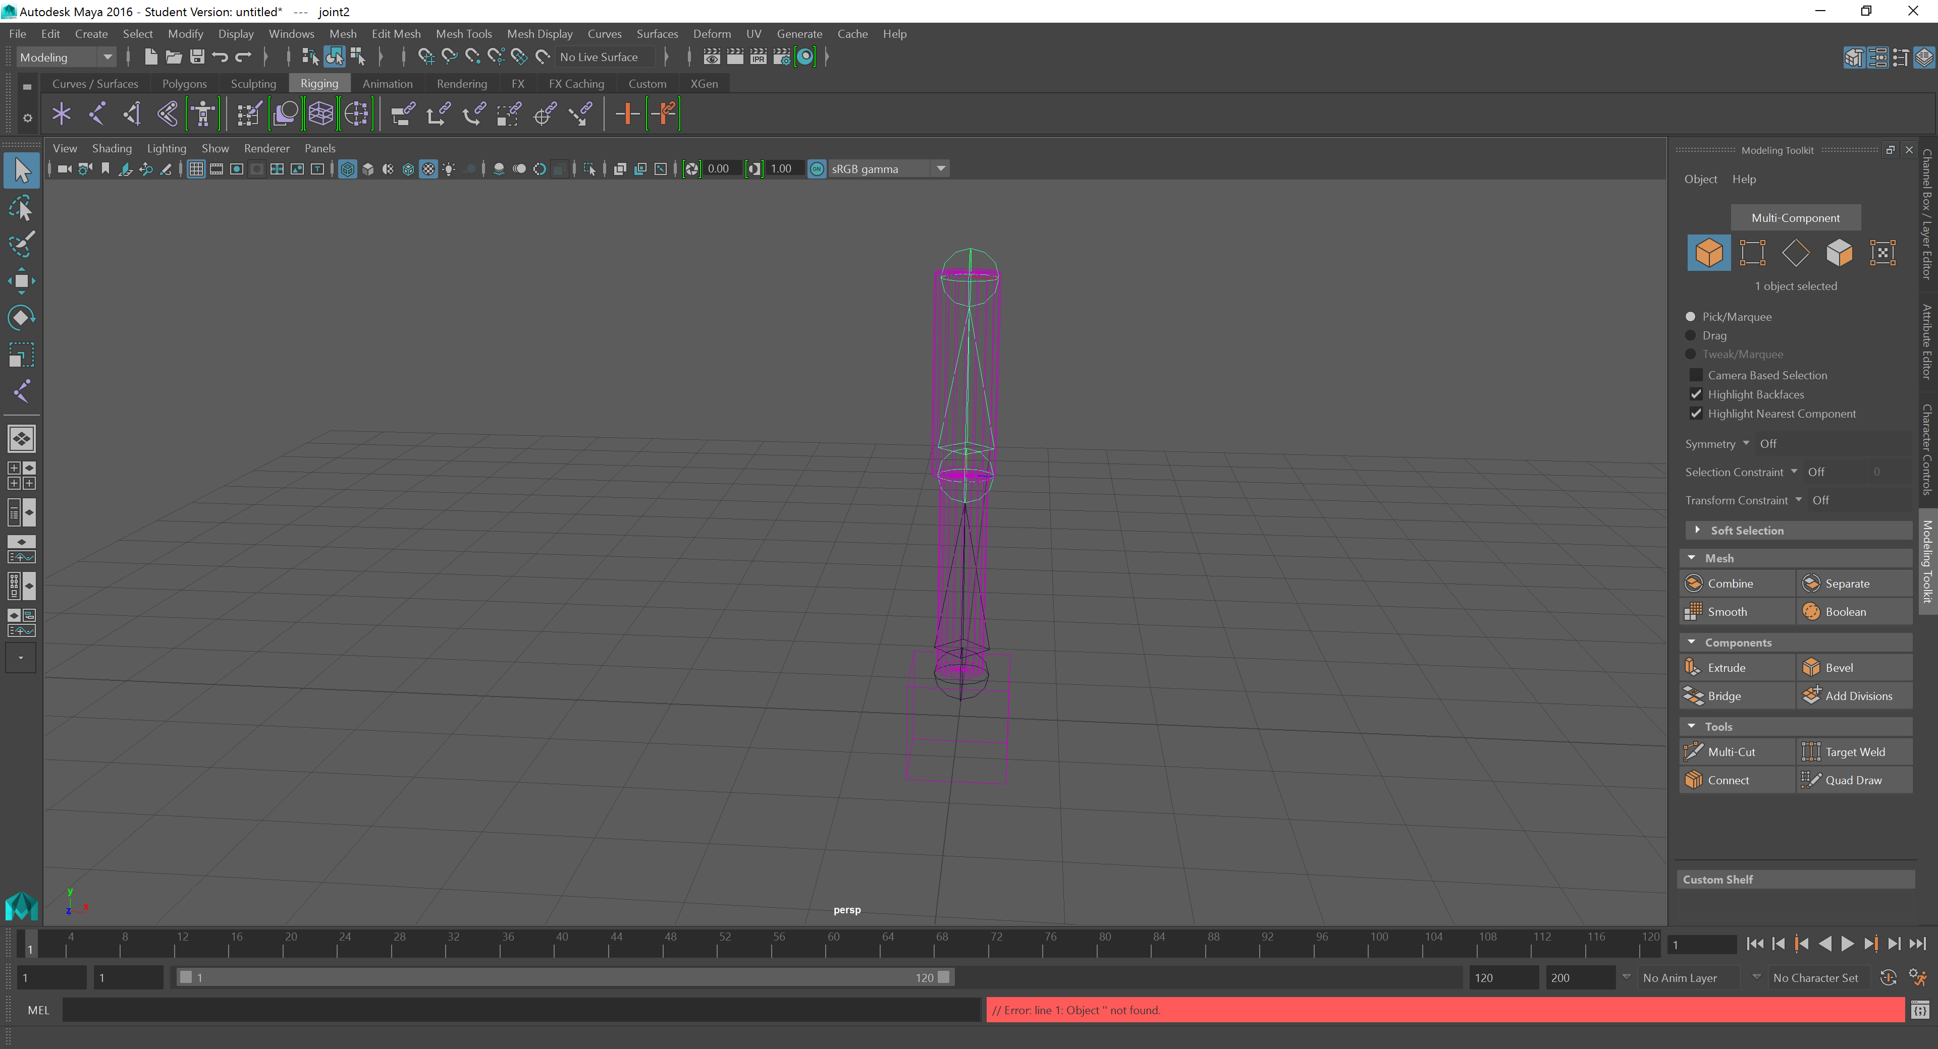

Slide 18
Joints
Don’t worry about valid ranges of motion at the moment
(You can restrict the movement of joints, but don’t worry about that)

Slide 19
Textures and Materials
Window menu -> Hypershade

Slide 20
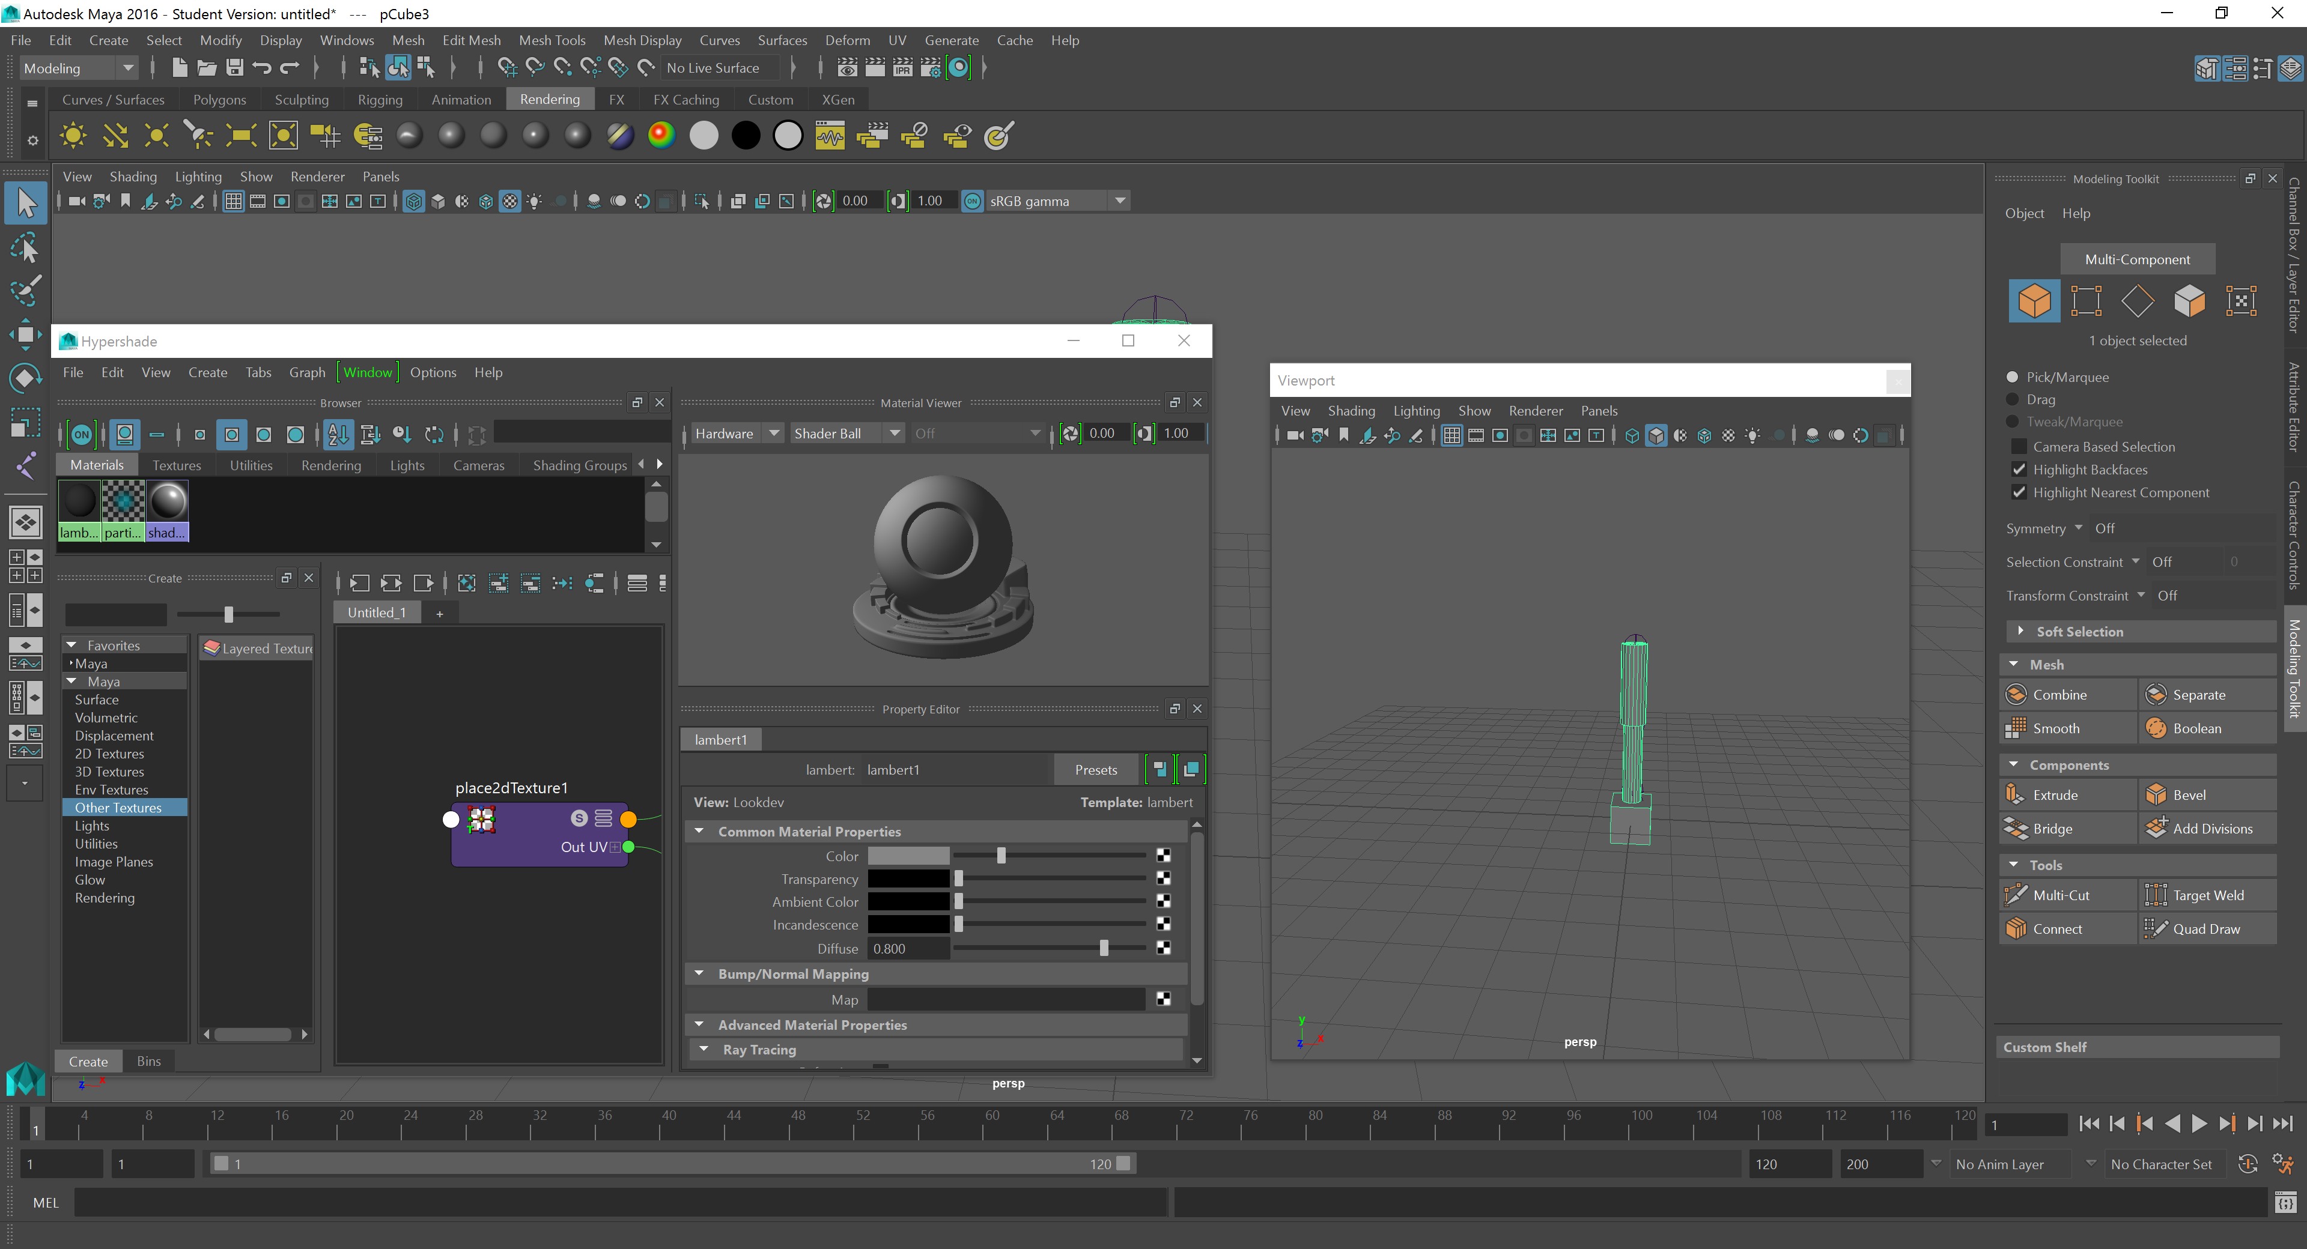

Slide 21
Lambert, Blinn etc
So we can make materials Lambertian or Blinn
You should at this point know what that means.

Slide 22
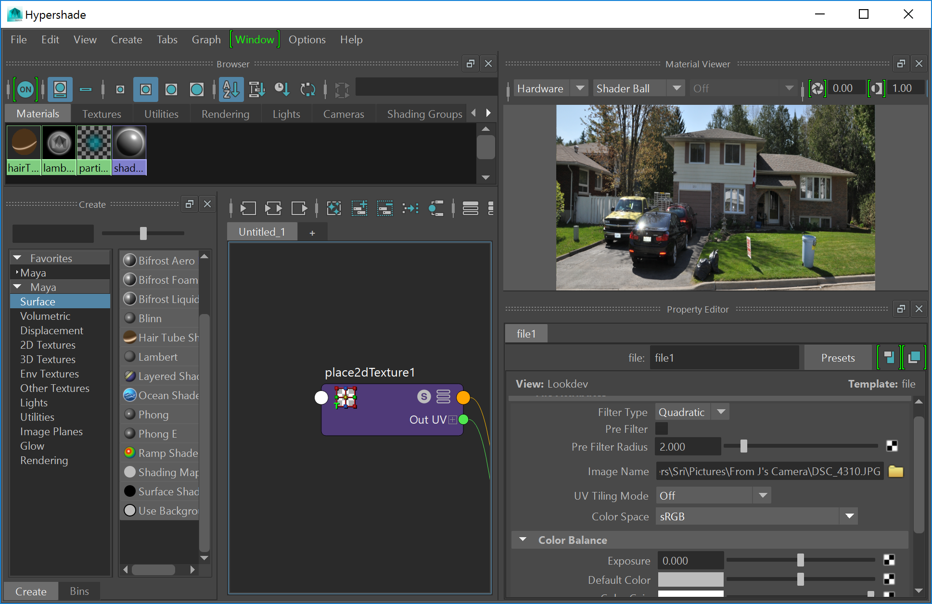
Texture That little black/white square beside colour

Slide 23
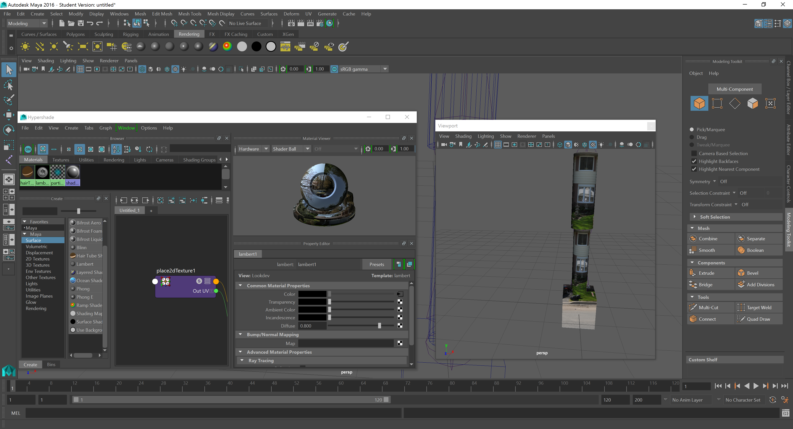

Slide 24
That’s nonsense?
Well yes, and no
It’s using an algorithm to apply a texture to the image
It’s just an unsuitable image
But it will let you project any image onto any shape.

Slide 25
Loading A file
So one option is that we could develop our own file format
Say, store a list of points, and a list of triangles which point to each triangle
Which is conceptually simple, but not exceptionally helpful

Slide 26
Sri – Open the sphere.ma file with Notepad++
(If you miss this in class it’s just a 3D sphere in a maya ASCII format that approximates human readable)

Slide 27
Contents of a File
So we have to step forward a bit conceptually
There are two kinds of objects we might be interested in.
Static objects… which is what we’ve been focusing on, and animated ones.

Slide 28
Static And Animated Objects
Conceptually static objects are a subset of animated ones.
Animated objects are composed of static objects that move (rigid body dynamics).
Deforming an object with a matrix transformation should, in principle apply equally well to static or animatable ones (soft body dynamics)

Slide 29
Static And Animated Objects
In practice though, file formats tend to distinguish the two, and until relatively recently you tended to use different file types for different types of objects
But let’s not do that. Let’s do what anyone sane does, and use one file format

Slide 30
Formats
.FXB – by Autodesk, game industry standard, has a C++ plugin, works with Maya and Blender
.X3D ISO standard, in HTML 5, but it also encapsulates behaviours the way you would program them in WebGl or Directx etc… so stay away!
(Unreal and Unity both have their own file formats which Maya can export to as well)

Slide 31
Actually Loading the Files
If you need a longwinded tutorial to follow (which you will)
http://www.walkerb.net/blog/dx-4/

Slide 32
Actually Loading Real Files
I’m assuming between downloading maya/blender and learning the very basics of building something you’re going to run out of time.
The next lab is on how to load the objects

Slide 33
You need to download and install the FBX SDK from Autodesk
http://usa.autodesk.com/adsk/servlet/pc/item?id=24746731&siteID=123112
Add it to the included directories in Visual studio
Include it in your project as an additional dependency
Add it to the linker
Put the right .dll in your debut/release directory
You might need a reference to a debugging symbol (though hopefully not for what we do)

Slide 34
#include <fbxsdk.h>

Slide 35
FBX
FBX can load both meshes and materials

Slide 36
FBX
On my computer
D:\Program Files\Autodesk\FBX\FBX SDK\2016.1.2
(Yours will probably be C:\...)
They have samples, a lot of samples
For some unknown reason they don’t give you a visual studio solution file that can let you pick your sample, but they have projects for everything.

Slide 37
A3
For A3 I’m going to ask you to import models made in maya or blender
Starting from one of these samples might be helpful… just saying
We’re going to start adding materials and lights and that sort of thing

Slide 38
Movement
Part of the point of this is that we want to get to the stage of talking about animation
If you want something other than your project to putter away on over reading week, making a model with a few movable parts might be sensible….
(Think about say a pendulum)

